Slide 1
Session-13
Linear transformations of random variables,
Properties of variance
Sum of random variables

Slide 2
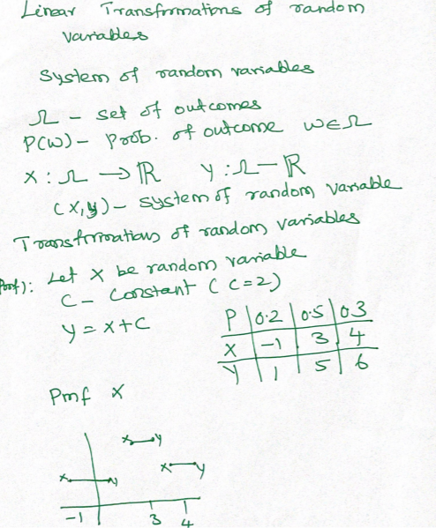
Linear transformations of random variables- Addition

Slide 3
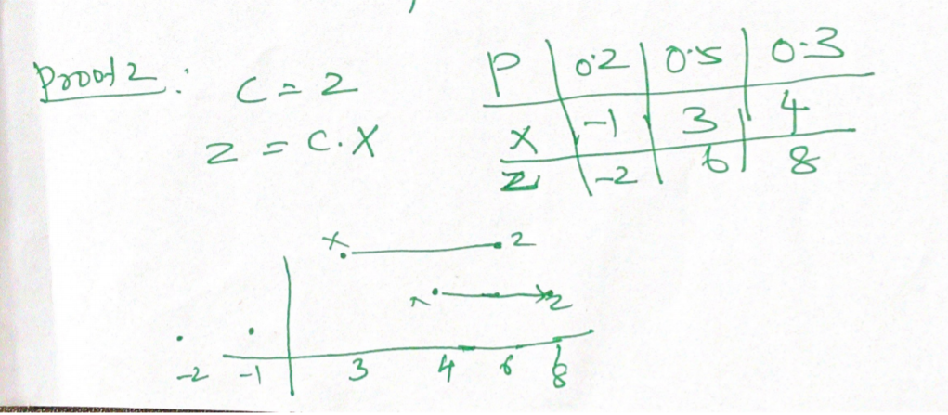
Linear transformations of random variables- Multiplication

Slide 4
A random variable
A random variable is a variable that denotes the outcomes of a chance experiment.
For example, suppose an experiment is to measure the arrivals of cars at a tollbooth during a minute period. The possible outcomes are: 0 cars, 1 car, 2 cars, …, n cars.
There are two categories of random variables
(1) Discrete random variable
(2) Continuous random variable.

Slide 5
Types
Discrete distributions include the binomial distributions, Poisson distribution and hypergeometric distribution.
Continuous distributions include the normal distribution, uniform distribution, exponential distribution, t distribution, chi-square distribution and F distribution.

Slide 6
Properties of a Random Variable
It only takes the real value.
If X is a random variable and C is a constant, then CX is also a random variable.
If X₁ and X₂ are two random variables, then X₁ + X₂ and X₁ X₂ are also random.
For any constants C₁ and C₂, C₁X₁ + C₂X₂ is also random.
|X| is a random variable

Slide 7
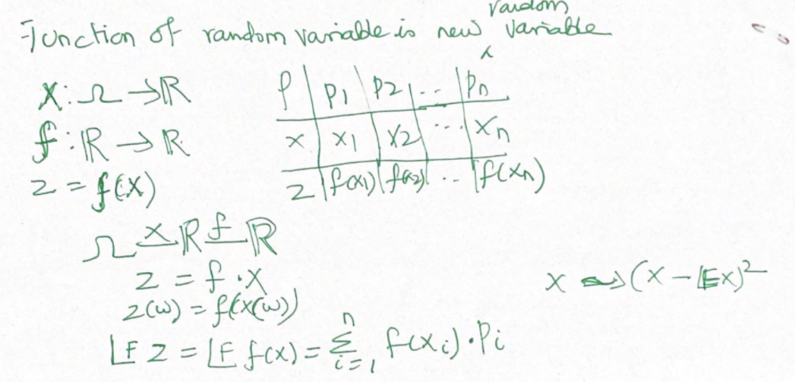
Functions of Random Variable

Slide 8
Example
The average salary for an employee at Acme Corporation is $30,000 per year. This year, management awards the following bonuses to every employee.
A Christmas bonus of $500.
An incentive bonus equal to 10 percent of the employee's salary.
What is the mean bonus received by employees?
(A) $500 (B) $3,000 (C) $3,500 (D) None of the above. (E) There is not enough information to answer this question.

Slide 9
Contd..
Y = mX + b Y = 0.10 * X + 500
where Y is the transformed variable (the bonus), X is the original variable (the salary), m is the multiplicative constant 0.10, and b is the additive constant 500.
mean salary is $30,000, we can compute the mean bonus from the following equation.
Y = mX + b Y = 0.10 * $30,000 + $500 = $3,500

Slide 10
Variance, Covariance, Correlation
The difference between variance, covariance, and correlation is:
Variance is a measure of variability from the mean
Covariance is a measure of relationship between the variability of 2 variables - covariance is scale dependent because it is not standardized
Correlation is a of relationship between the variability of 2 variables - correlation is standardized making it not scale dependent

Slide 11
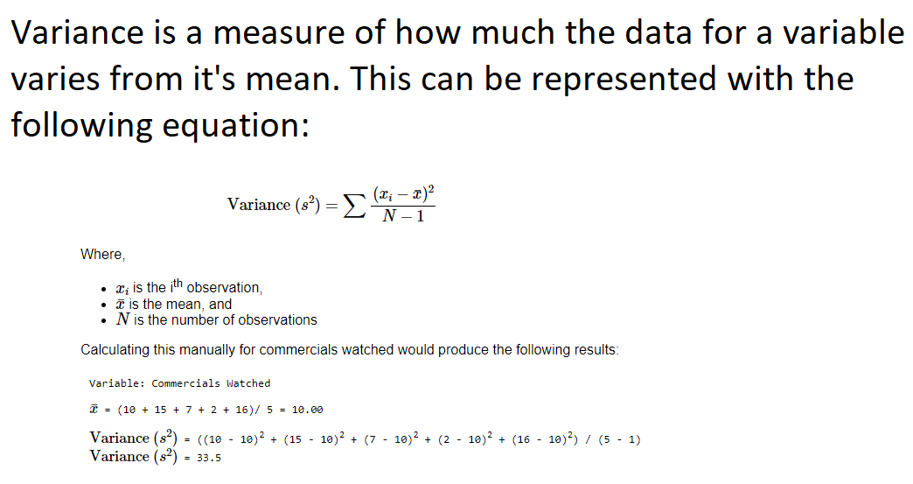
Variance

Slide 12
Importing Packages in Python
import pandas as pd
import numpy as np
# Setting a seed so the example is reproducible
np.random.seed(4272018)
df = pd.DataFrame(np.random.randint(low= 0, high= 20, size= (5, 2)),
columns= ['Commercials Watched', 'Product Purchases'])
df

Slide 13
Calculating Variance
df.agg(["mean", "std"])
df.var()

Slide 14
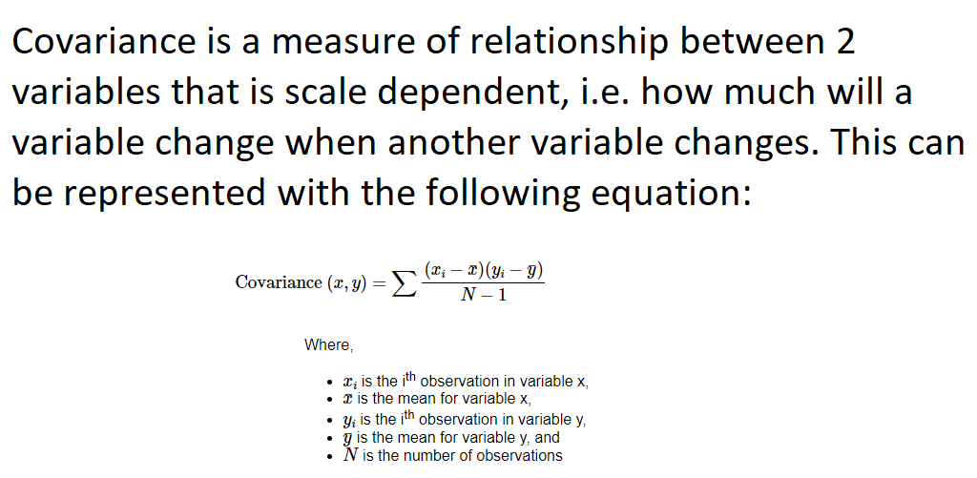
Covariance

Slide 15
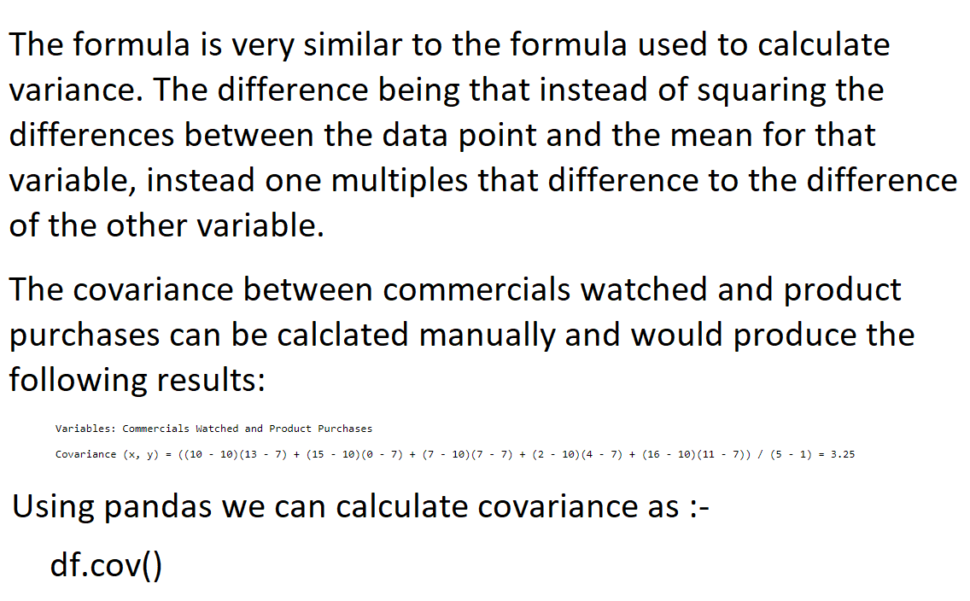
Covariance contd..

Slide 16
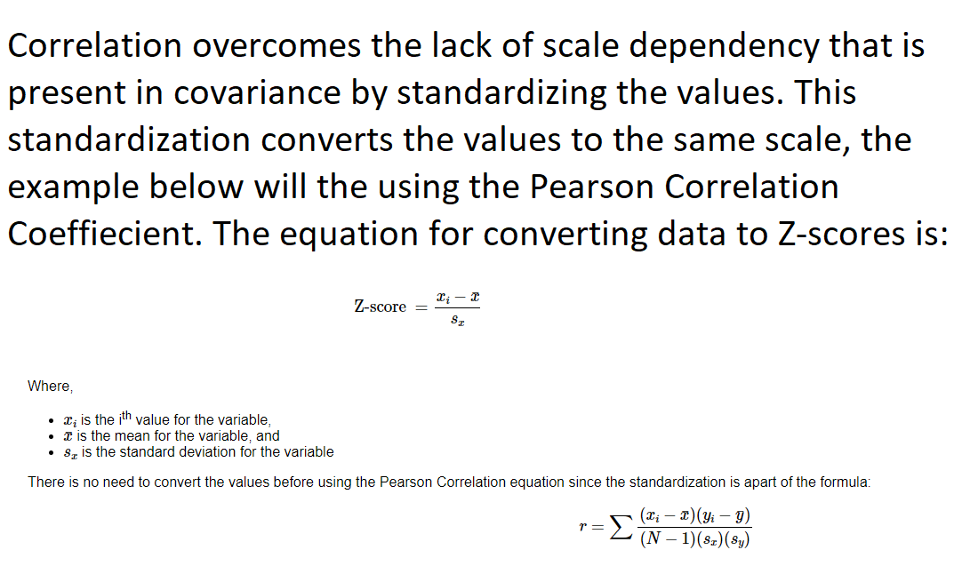
CORRELATION

Slide 17
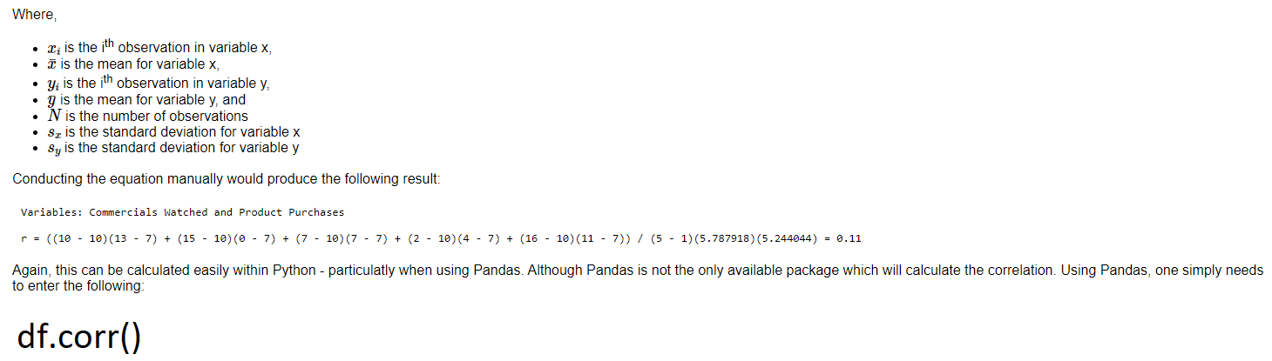
Correlation contd..

Slide 18
Correlation contd..
The Pearson Correlation Coefficient will always range between -1 to 1. The closer the correlation coefficient is to -1 or 1, the stronger the relationship; whereas, the close the correlation coefficient is to 0, the weaker the relationship is.
If the correlation coefficient is positive, this indicates that as one variable increase so does the other. However, if the correlation coefficient is negative, it indicates that as one variable increase the other decreases.
An easy way to see this relationship is to plot is using a scatter plot. Currently there is no agreed on threshold for how to interpret the coefficients.
Akoglu, (2018) provides the following table with the three most commonly used suggestions for how to interpret the correlation coefficients - the fields vary a bit.
There are other measures of correlation, such as: Spearman's rank correlation, Kendall's tau, biserial, and point-biseral correlations. Each correlation measure has different assumptions about that data and are testing different null hypotheses.

Slide 19
Properties of variance
For any two random variables XX and YY, the expected value of the sum of those variables
will be equal to the sum of their expected values.
Property 1: E (X + Y) = E (X) + E (Y).
Property 2: E (X₁ + X₂ + … + X_{n}) = E (X₁) + E (X₂) + … + E (X_{n}) = Σ_{i} E (X_{i}).
Property 3: E (XY) = E (X) E (Y). Here, X and Y must be independent.
Property 4: E [aX] = a E [X] and E [X + a] = E [X] + a, where a is a constant
Property 5: For any random variable, X > 0, E(X) > 0.
Property 6: E(Y) ≥ E(X) if the random variables X and Y are such that Y ≥ X.
Property 7: The variance of a constant is 0.
Property 8: V [aX + b] = a² Var (X), where a and b are constants.
Property 9: V (a₁X₁ + a₂ X₂ + … + a_{n}X_{n}) = a₁² V(X₁) + a₂² V(X₂) + … + a_{n}² V(X_{n}).

Slide 20
Sums of Random Variables
Let be a sequence of random variables, and let be their sum:

Slide 21
Mean and Variance of Sums of Random Variables
The expected value of a sum of n random variables is equal to the sum of the expected values:
Note: regardless of the statistical dependence of the r.v.

Slide 22
Mean and Variance of Sums of Random Variables
Variance of sum of r.v.

Slide 23
Mean and Variance of Sums of Random Variables
Since that the covariance is not necessarily equal to zero in general, the variance of sum is not necessarily equal to the sum of variances of each r.v..
In case that all the r.v. are independent, the covariance will be zeros. Then

